Slide 1

Fraudulent Activity Analysis
Jade Selke
November 25, 2022

Slide 2

Goals
Representative Dataset
Identify Money Laundering or Fraud
Use Outliers to Find Cases
Notes:
Some time ago, we were notified of potential money laundering or fraud within our systems, and so the tech team prepared a representative dataset of 10,000 rows of transactions from our records. Given that dataset, first I needed to establish the potential to money laundering in the dataset, and then I used outliers to find a few specific cases that may be worth researching further, or that could be used in building algorithms to search through the database for similar cases to let our security teams delve further.

Slide 3
Dataset Overview and Benford’s Law
Summary Data
Credits |  | Debits
Mean | $ 105,680.47 | Mean | $ 104,993.99
Median | $ 83,700.00 | Median | $ 85,263.00
Mode | $ 30,300.00 | Mode | $ 88,945.50
Standard Deviation | $ 86,604.71 | Standard Deviation | $ 85,268.18
Kurtosis | 1.96 | Kurtosis | 2.41
Range | $ 380,200.00 | Range | $ 429,396.50
Minimum | $ 9,100.00 | Minimum | $ 8,963.50
Maximum | $ 389,300.00 | Maximum | $ 438,360.00
Count | 3,840 | Count | 6,160
Notes:
The representative dataset is transactions from January 1st, 2000 to March 3rd, 2001 with a total of 10,000 transactions. Summary data of the set was generated in Excel. A total of 3,840 deposits and 6,160 withdrawals were noted, averaging about $105,000 in both, but having median values closer to $84,000.
This shows a skew in the dataset, which can also be seen with the relatively large Kurtosis values greater than one, which means long tails on a histogram or bell curve of overall transactional data. The minimum and maximum deposits were about $9,100 and $389,000 and withdrawals were $8,900 and $429,000.
Digging a little deeper, Benford’s Law was applied to the dataset to ensure that the chance of fraud was likely. According to John Gill of ACFE Insights (2019), Benford’s Law relies on the idea that the distribution of the first digit of multi-digit numbers in a data set follows a natural pattern, such that the numbers generated are not human-generated or randomly generated. In this case, this set should be assumed to be natural unless humans are specifically modifying transactions to hide specific activity like fraud.
Looking at the probability of the 1st digit of the transactional data in this dataset compared with the probability distribution established by Benford’s Law, shown in the Excel generated chart on the right as purple and blue respectively, a few cases jump out as not following the pattern. Specifically, transactions beginning with a 1 and 9, such as $10,000 or $97,000 occur too frequently, and numbers beginning with a 2, 4, or 5 do not occur often enough. This is a clear indicator for this dataset in general that the transactions have been modified by our clients and deserve further examination.

Slide 4

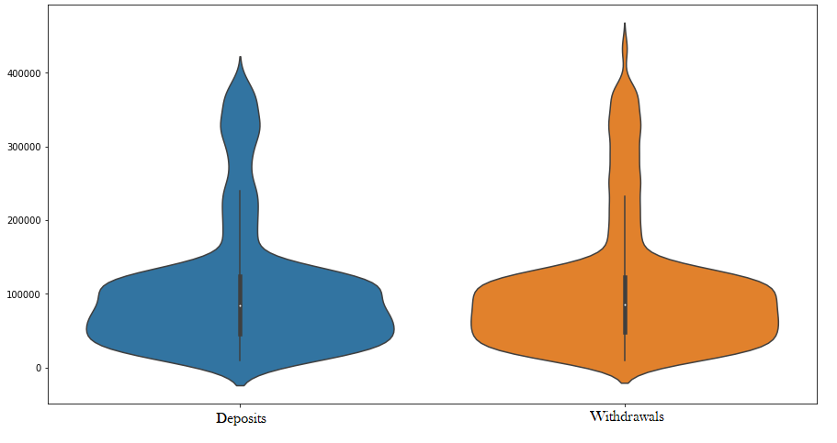
Dataset Transaction Amount Analysis
Notes:
The dataset sampled contains information on withdrawal or deposit, amount, date, and account from and to which includes company name, bank, and country. After a quick analysis of the withdrawal and deposit information, high amount transactions stand out as outliers, show in the violin plot shown here generated in python.
This is like a boxplot, showing quartiles, except that volume is shown as width of the chart. Upper values, deposits and withdrawals above $250,000 are all considered outliers here. The highest withdrawal and deposit amount will be included shortly for further analysis.

Slide 5
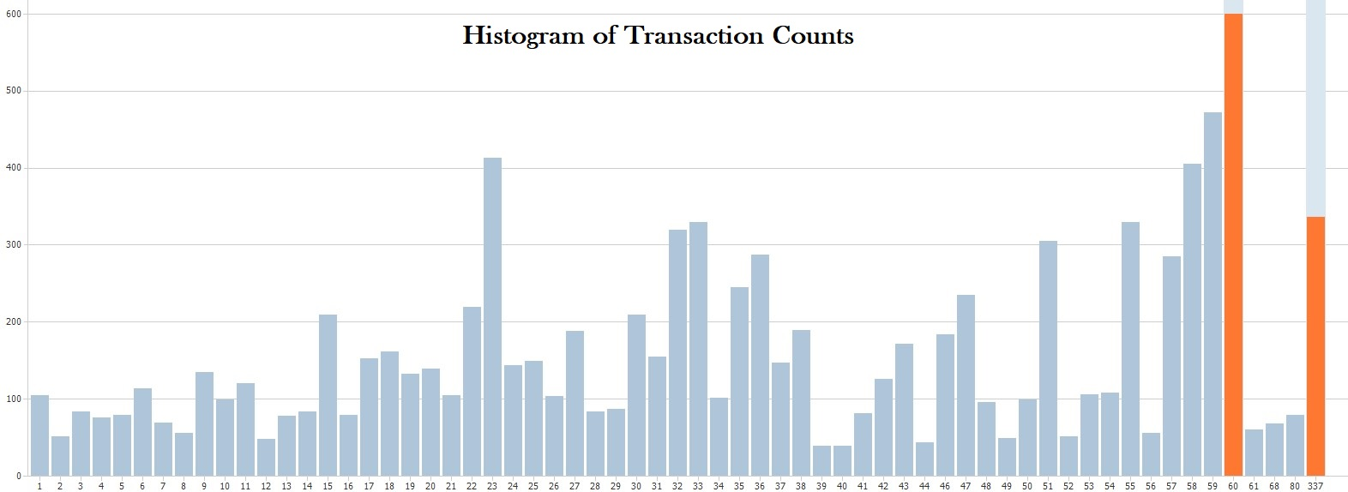
Data Transaction Count Analysis
Notes:
This histogram, generated in i2, shows counts of transactions by entity. The outliers that will be focused on are 337, done by a single entity, and 60, which accounts for 10 different entities as well as the highest number of overall transaction counts for the set of 10,000.

Slide 6
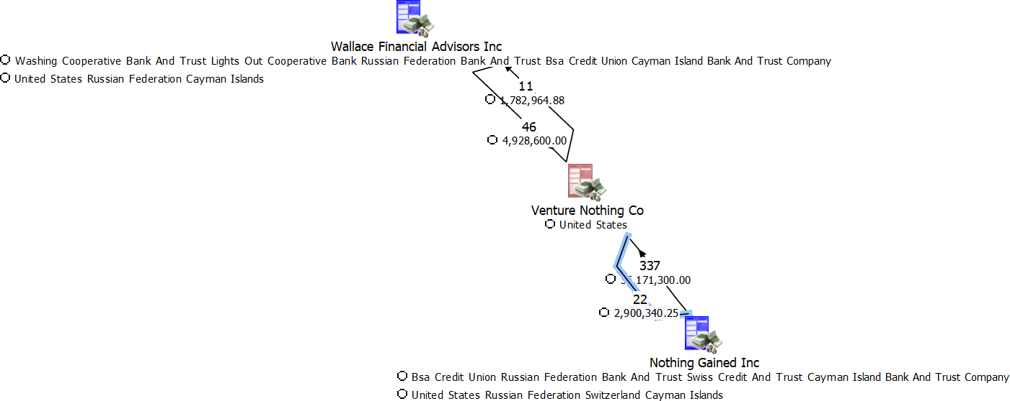
OUTLIER – TRANSACTIONS Withdrawal value and count
Notes:
Looking to the outliers for highest single entity transaction count as well as highest withdrawal of $438,360, the link between Venture Nothing Co and Nothing Gained Inc is show here with their single other entity link, Wallace Financial Advisors Inc , generated in i2.
The single withdrawal is highlighted in blue, next to the deposit count from Nothing Gained of 337. Based on this chart, transactions go back and forth between these entities, however, further inspection reveals this is not the case.

Slide 7
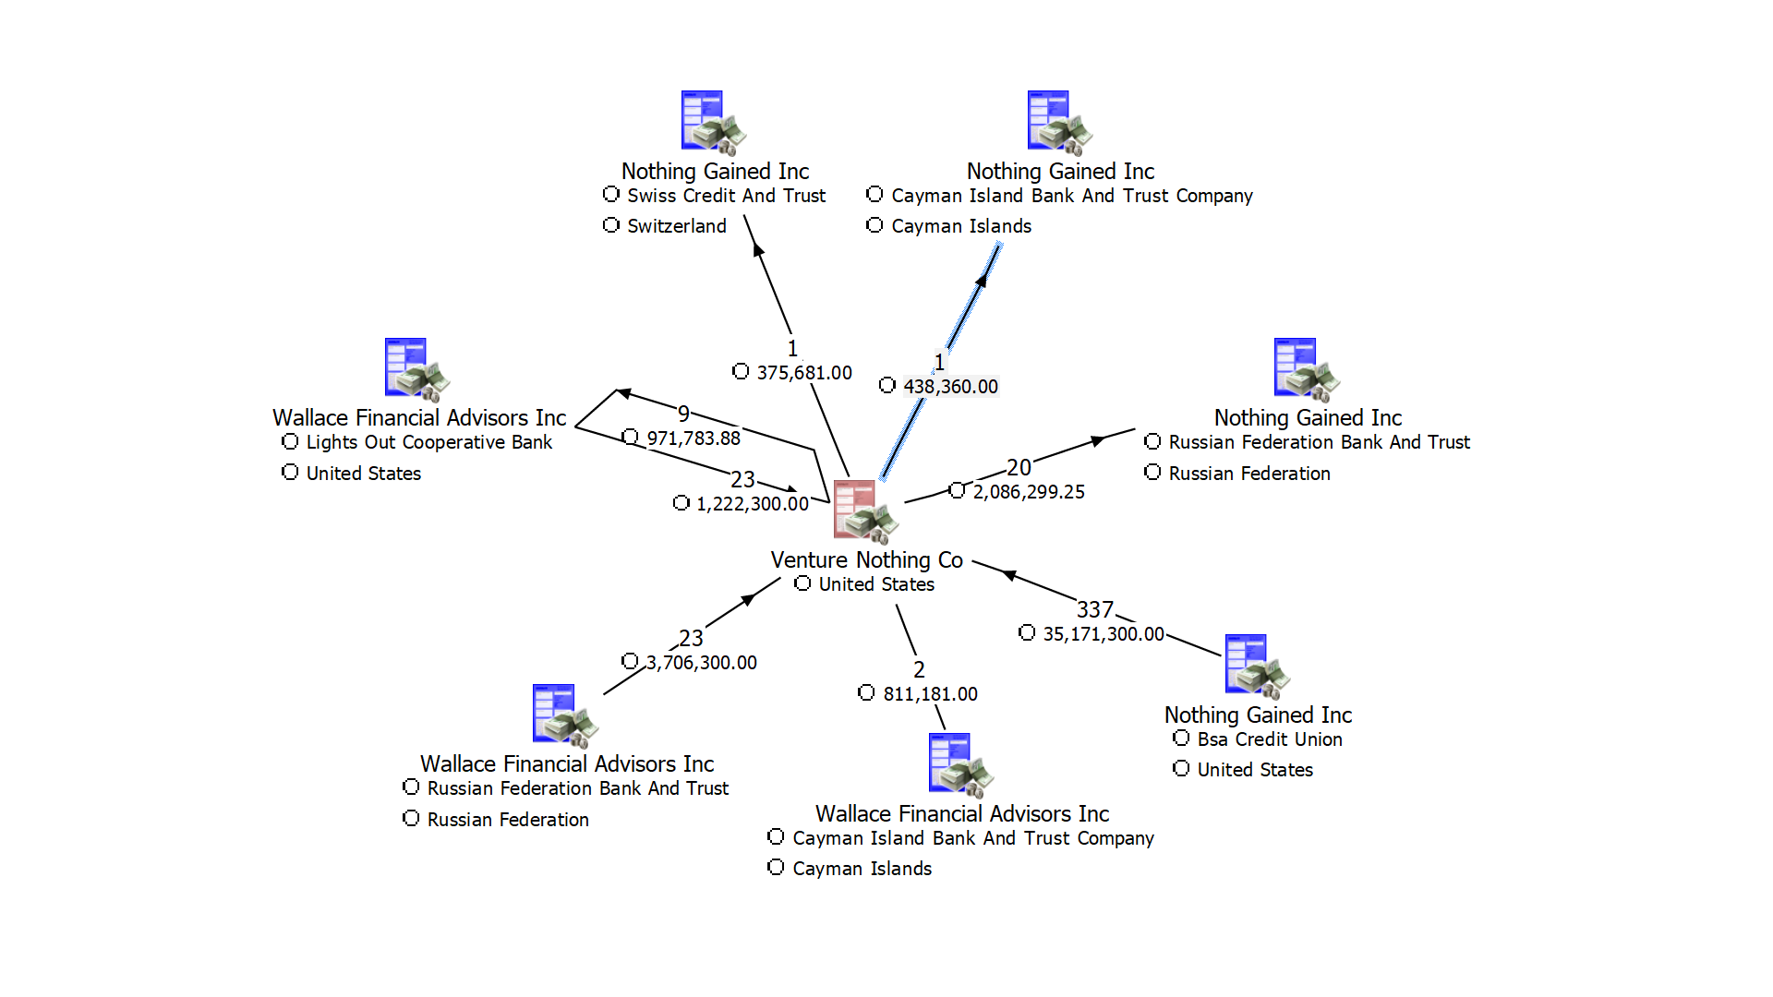
OUTLIER – TRANSACTIONS Withdrawal value and count
DELINEATED by COUNTRY
Notes:
Breaking these transactions down by country, the single withdrawal of $438,360 went into a Cayman Islands account, and the 337 transactions were also one sided from Nothing Gained to Venture Nothing within the US, at the 4 o’clock position in this chart from i2. 337 transactions would account for almost 6 transactions per week on average from a single entity.
This chart also shows that almost all transactions are moved from Nothing Gained within the US to Venture Nothing back to Nothing Gained outside of the US. This may be a sign that the movement of money is trying to be obscured through Venture Nothing as an intermediary. Based on this transaction movement, Venture Nothing and Nothing Gained are entities worth researching further for possible money laundering activity.

Slide 8
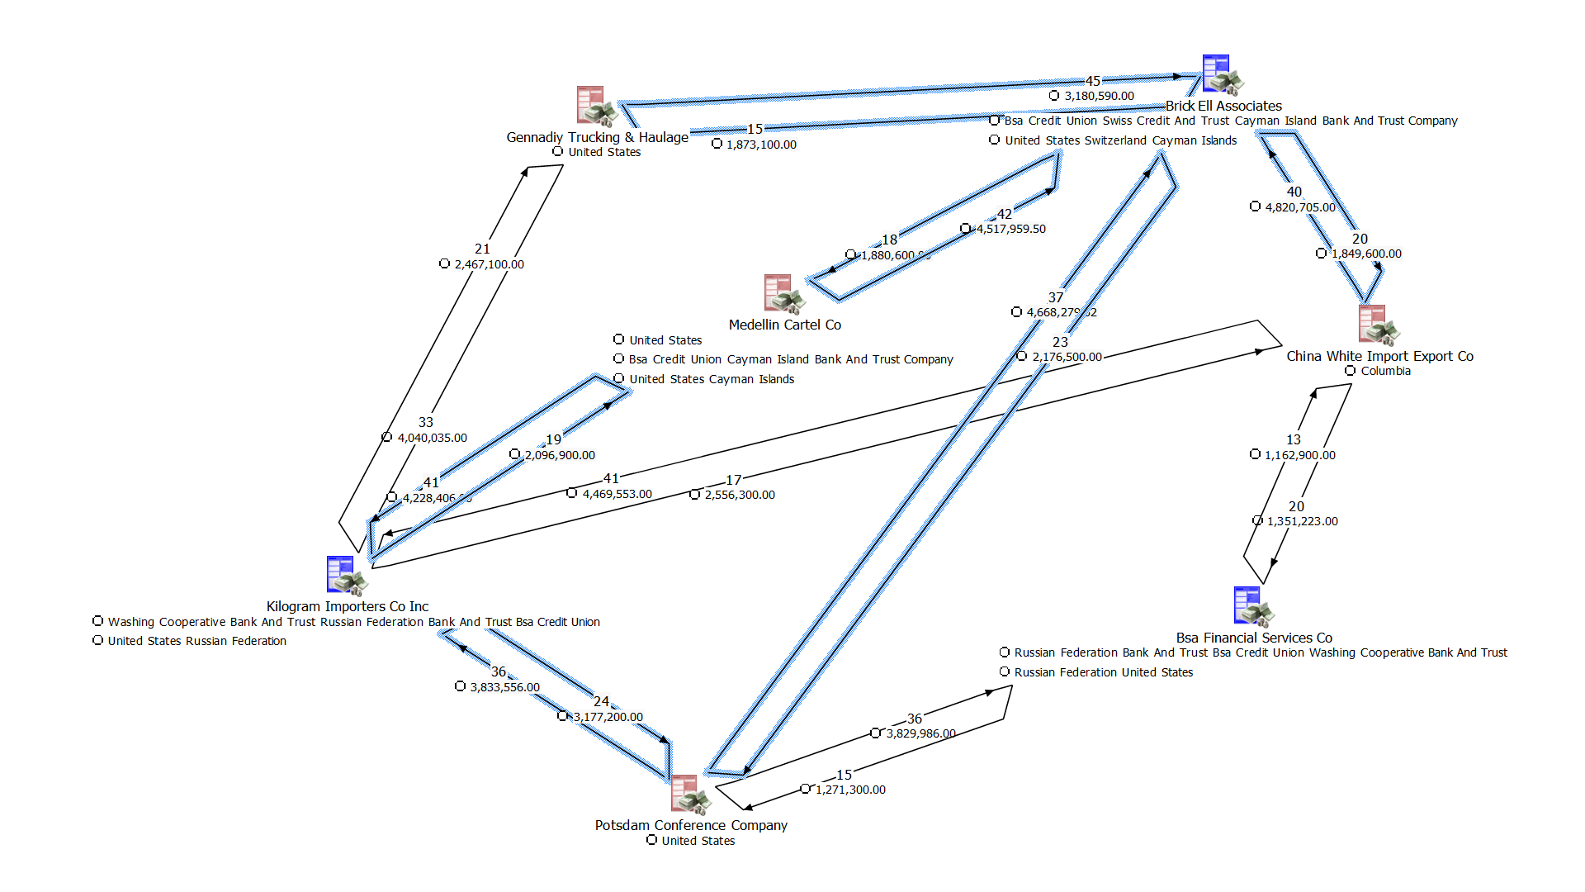
Outlier – Transaction Deposit Value and Multi Count
Notes:
Looking to the outlier for largest single deposit as well as transaction counts, we’ll look at this group of entities generated in i2. The largest single deposit is part of the 15 links from Gennadiy Trucking and Haulage to Brick Ell Associates along the top at $389,300. Along with that, highlighted in blue are a total of six groupings of sixty transactions, an average of one per week in the dataset’s timeframe.
However, none of these transactions follows a set timeframe of movement that could be discerned, which may signify an attempt to hide money movement. This chart also shows movement of large amounts of money from the US, Russia, the Cayman Islands, Columbia and back again through what may be several intermediary entities. Based on this, all seven of these entities are worth further consideration.

Slide 9

Analysis Results
Indicators of unnatural transactions based on Benford’s Law
Multiple outliers are present in the data
Use identified outliers for further analysis and to find more outliers
Notes:
Based on the initial analysis of the dataset, the transactions do not follow what would be expected if they were natural transactions according to Benford’s Law. This suggests that the transactions have been manipulated to hide fraud or money laundering.
Deeper analysis of the full dataset revealed that there are multiple outliers in the upper ranges of withdrawals and deposits that deserve further research, as well as the overall count of transactions on an entity basis.
Finally, two specific groups of entities were identified for further analysis to ensure the outliers do show evidence of money laundering, money movement between Nothing Gained to Venture Nothing back to Nothing Gained in one direction and movement back and forth between a group of seven entities based on identical transaction counts that don’t occur over patterned intervals that also includes an outlier for highest deposit amount.
From this analysis, this data set contains clear indicators of money laundering, and further Automated Machine Learning algorithm implementation and improvements on the algorithms based on these findings are recommended for the next steps moving forward.

Slide 10
References
Gill, J. (16 May, 2019) What Is Benford's Law and Why Do Fraud Examiners Use It? ACFE Insights. https://www.acfeinsights.com/acfe-insights/what-is-benfords-law
Smith, D. (2022). Raw Data Sheet. FCM_642_Raw_Data_10_000_Transactions_wit.csv retrieved from https://engage.utica.edu on 21 November, 2022

